Slide 1
Encryption Methods
Two fundamental approaches are in use:
Conventional Encryption, also known as symmetric encryption
Public-key Encryption, also known as asymmetric encryption

Slide 2
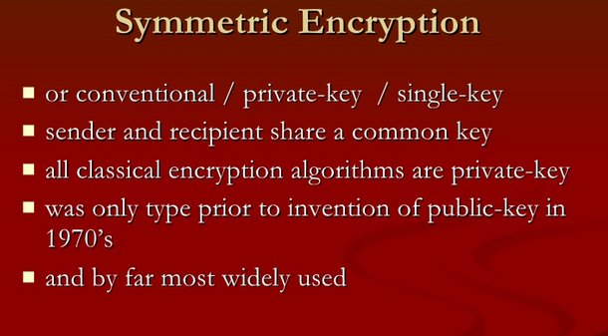

Slide 3
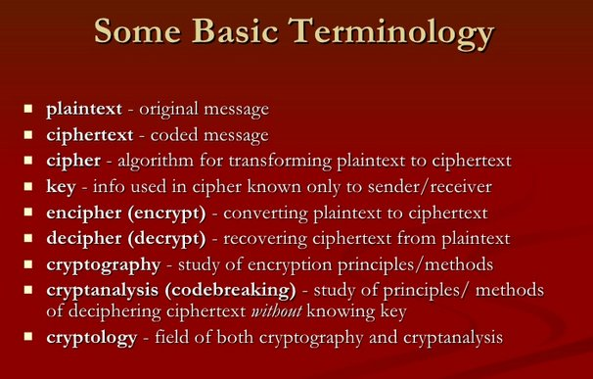
Notes:
Briefly review some terminology used throughout the course.

Slide 4
Conventional Encryption
Five components to the algorithm
Plaintext: The original message or data that is fed into the algorithm as input
Encryption algorithm: Performs various substitutions and transformations on the plaintext
Secret key: Input to the encryption algorithm. Substitutions and transformations performed depend on this key
Ciphertext: Scrambled message produced as output. Depends on the plaintext and the secret key
Decryption algorithm: Encryption algorithm run in reverse. Uses ciphertext and the secret key to produce the original plaintext

Slide 5
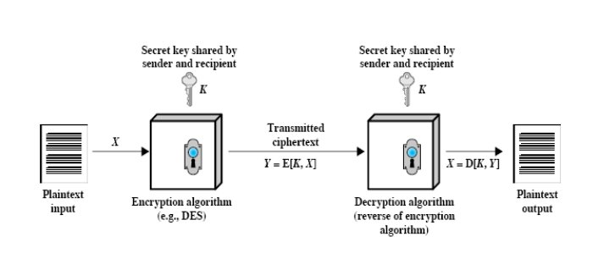
Symmetric cipher model

Slide 6
Classification of Cryptographic Systems
i) The type of operations used for transforming plaintext to ciphertext
Substitution
Transposition
Product
ii) The number of keys used
Hash functions: no key
Symmetric (single key)
Asymmetric (two-keys, or public-key encryption)
iii) The way in which the plaintext is processed
Block cipher
Stream cipher

Slide 7
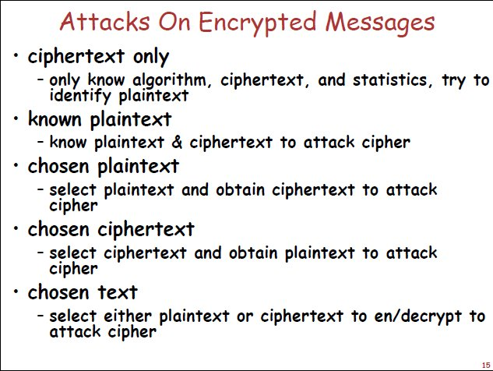

Slide 8
Classical Symmetric Cipher
Substitution ciphers – replace bits, characters, or blocks of characters with substitutes
Transposition ciphers – rearrange bits or characters in the data

Slide 9
Substitution ciphers
Monoalphabetic
(Ceaser cipher)
Polyalphabetic
(playfair and Vigenere Cipher)

